Slide 1


Slide 2


THE IDENTIFICATION OF
SPAM MAILS
Haoran Ding, MEng
Patrick Adjei, MEng
Pengshuo Liu, MEng
Zhaokai Sun, MEng
Data Analytics Foundations
Data Analytics Foundations

Slide 3
Section
Problem Description
Data Preparation
Algorithm Models
Results
Conclusion
Future Consideration
Data Analytics Foundations

Slide 4
Problem Description
Data Analytics Foundations

Slide 5
What is spam mail?
Spam email, also known as junk email, is unsolicited messages sent in bulk by email.
Most spam email spam are dangerous. Because they may contain links that lead to phishing web sites or include malware as file attachments.
Data Analytics Foundations

Slide 6
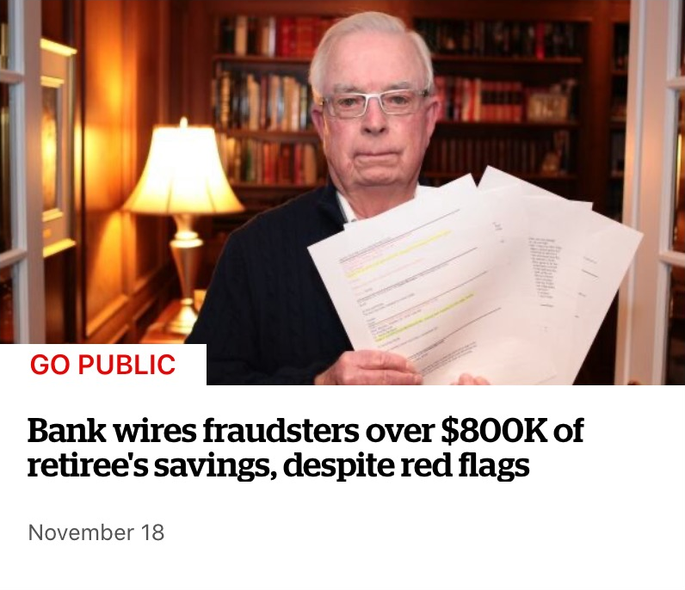
Case
“An email supposedly from the realtor handling the sale, said the balance should go to a different bank.”
--CBC News
Data Analytics Foundations

Slide 7
How to identify?
Traditional method
·Blacklist + User report
Our method
·NLP + Machine learning
Data Analytics Foundations

Slide 8
Data Preparation
Data Analytics Foundations

Slide 9
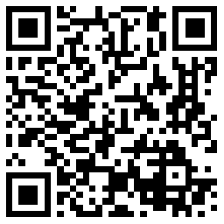
Data set introduction
Name: Spam Mails Dataset
Source: Kaggle
Column: 4
Row: 5171
Scan to download
Data Analytics Foundations

Slide 10
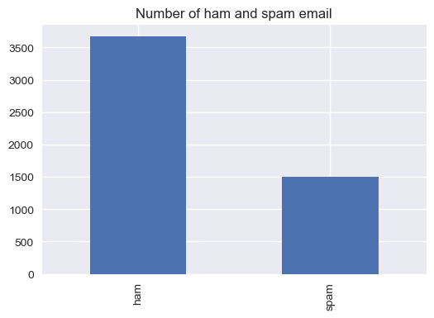
Data preparation
Ham : 3672
Spam: 1499
Data Analytics Foundations

Slide 11
Data preparation
 | label | text | label_num
14 | ham | Subject: meter 1431 - nov 1999 aimee , sitara deal 92943 for meter 1431 has expired on oct 31 , 1999 . settlements is unable to draft an invoice for this deal . this deal either needs to be extended or a new deal needs to be set up . please let me know when this is resolved . we need it resolved by friday , dec 17 . hc | 0
Original serial number
→ Meaningless
Action: Delete
Mail label
→ Repeated
Action: Keep one
Data Analytics Foundations

Slide 12
Data preparation
Subject: spring savings certificate - TAKE 30 % OFF
save 30 % when you use our customer appreciation spring savings certificate at foot locker , lady foot locker , kids foot locker and at our online stores !
CASE SENSITIVE
→ Change all to lowercase
STOP WORD
→ Delete all
“the most common words in a language”
SYMBOL AND NUMBER
→ Delete all
FORM OF WORD
→ Change all to original form
Data Analytics Foundations

Slide 13
Data preparation
Subject: spring savings certificate - TAKE 30 % OFF
save 30 % when you use our customer appreciation spring savings certificate at foot locker , lady foot locker , kids foot locker and at our online stores !
spring, saving, certificate
saving, customer, appreciation, spring, save, certificate, foot, locker, lady, foot, locker, kid, foot, locker, online, store
Data Analytics Foundations

Slide 14
Data preparation
·Feature engineering
Create word list
· Count the number of words
Use: sklearn - CountVectorizer()
· Calculate importance (TF-IDF)
Use: sklearn - TfidfTransformer()
Data Analytics Foundations

Slide 15
Algorithm Models
Data Analytics Foundations

Slide 16
Model selection
Naive Bayesian
Random Forest
Decision Tree
SVM
Ensemble Learning
(Hard voting & Soft voting)
Data Analytics Foundations

Slide 17
Results
Data Analytics Foundations

Slide 18
Accuracy comparison
Model | Accuracy
Naive Bayesian | 92.7%
Random Forest | 96.0%
Decision Tree | 93.5%
SVM | 96.7%
Ensemble Learning | 96.3%
Data Analytics Foundations

Slide 19
Conclusion
Data Analytics Foundations

Slide 20
Future Consideration
Data Analytics Foundations

